Slide 1



Tel: 0121 770 3168
Email: office@st-anthonys.solihull.sch.uk
Headteacher: Mr C. Flaherty
St Anthony’s Catholic Primary School,
Fordbridge Road,
Kingshurst,
Birmingham,
B37 6LW
Friday 17th July 2026
May 2026
.
This half term, we are growing to be attentive to our experience and to our vocation; and discerning about the choices we make and the effects of those choices.
.

Slide 2
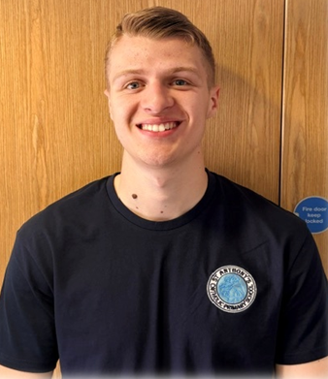
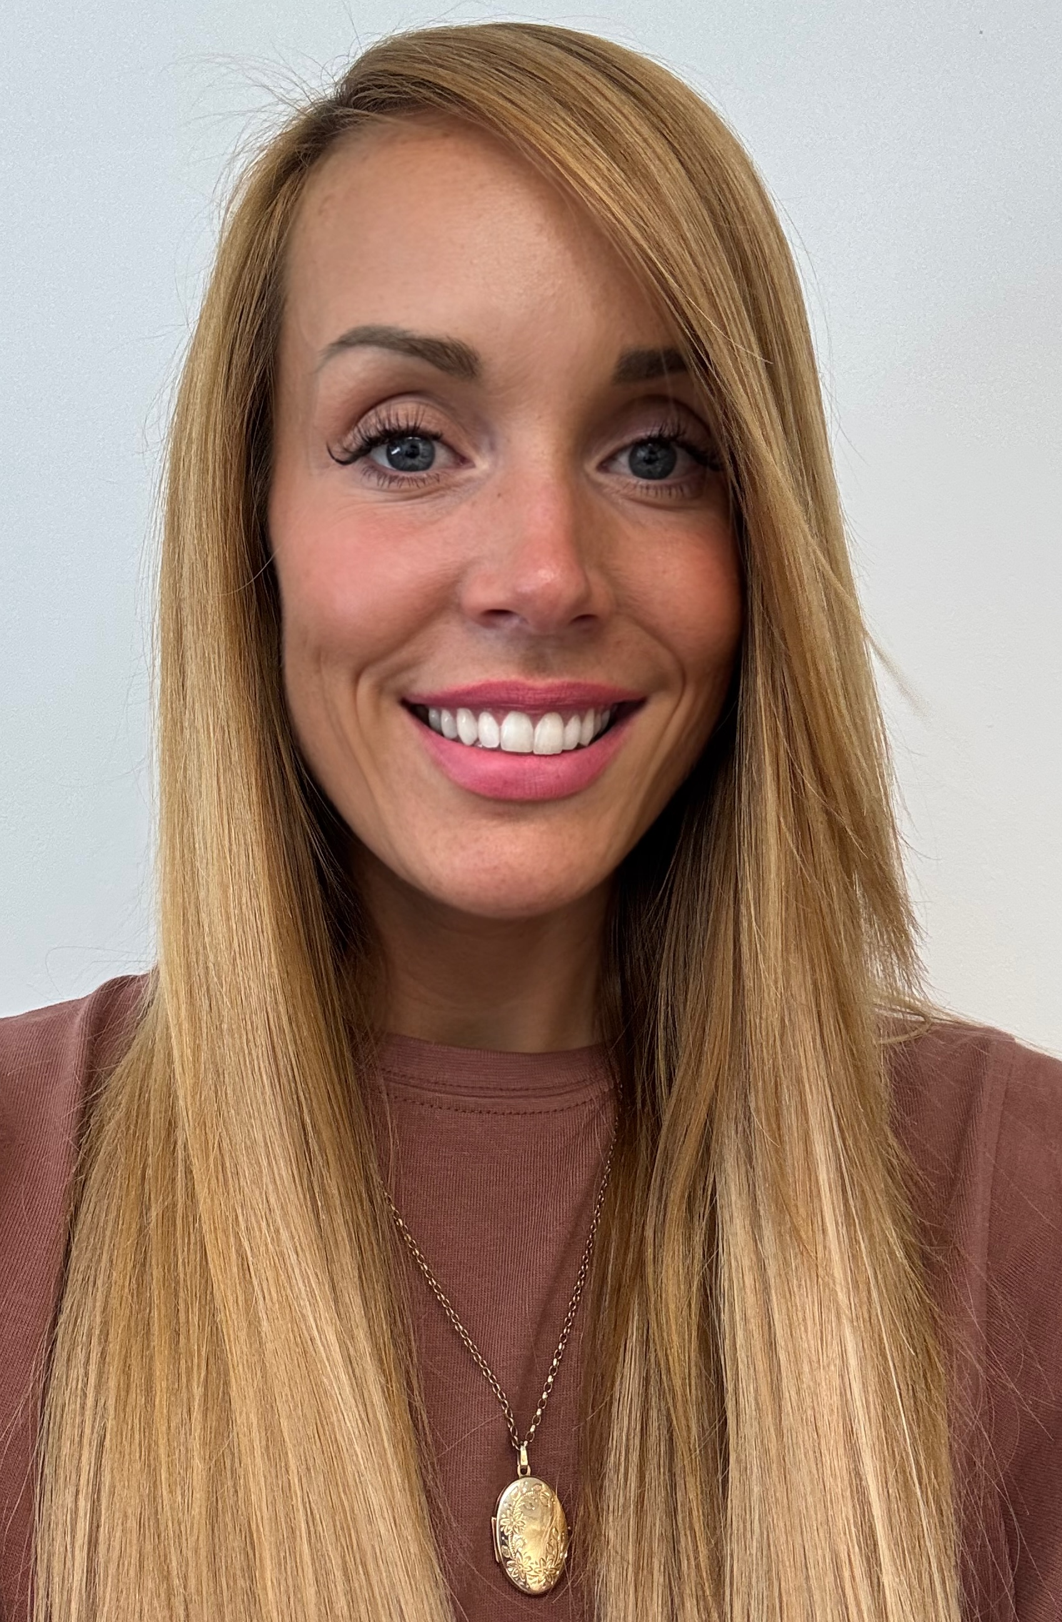
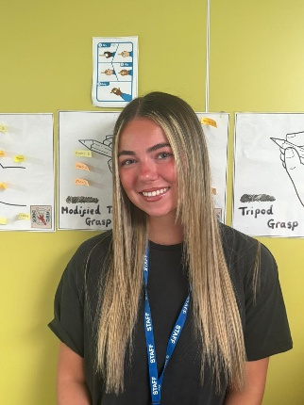

Staffing

Slide 3





PTA

Slide 4










Price increase September 2026
Over recent years we have ensured that our Nursery (chargeable sessions), Tiny Ants and Mighty Ants before and after school child care have remained the same price.
However, with the large increases in the cost of overheads, we now need to increase the prices to ensure that it doesn’t cost school. We have looked at other schools locally and across the MAC to ensure that our prices are reasonable. The new prices are displayed below:
Thank you for your understanding.
Provision (per session) | Current Price | Pricing from September 26
Tiny Ants am or pm sessions | £15.00 | £16.00
Nursery afternoon sessions | £15.00 | £16.00
Nursery from 2:50pm | £2.00 | £2.50
Breakfast Club | £6.00 | £6.50
Mighty Ants till 16:15 | £7.00 | £7.50
Mighty Ants till 17:15 | £8.00 | £8.50
Mighty Ants till 18:00 | £10.00 | £10.50

Slide 5

NEW Uniform Supplier

Slide 6

Tiny Ants Places, September 2026
.

Slide 7

Tiny Ants, September 2026
.

Slide 8

Nursery Places, September 2026
.

Slide 9

Nursery Places, September 2026
.

Slide 10

Social Supermarket
We are a 'Social Supermarket' based in Chelmsley Wood, here to those residents struggling with the cost of living.
We offer: 14 items of their choice from our shop shelves for £5.
They just need to scan the QR code on the poster and complete the membership form.

Slide 11

Water Safety Advice

Slide 12


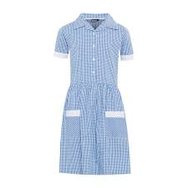
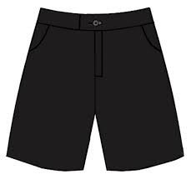
Summer Uniform
Summer uniform can be worn after Easter
until Autumn Term in October.
School Caps
School caps are recommended during the hot weather, these can be purchased from the School Office and are £6 (please pay on ParentPay)
**School caps only – no other caps to be worn**
Girls
*Grey skirt, trousers, pinafore or blue gingham dress
*White blouse with tie or blue or white polo shirt
*Black school shoes (no heels, no sandals)
*Blue school cardigan or jumper
Boys
*Grey trousers or school shorts
*White sleeved shirt with a school tie or blue or white polo shirt
*Black school shoes
*Blue school jumper

Slide 13
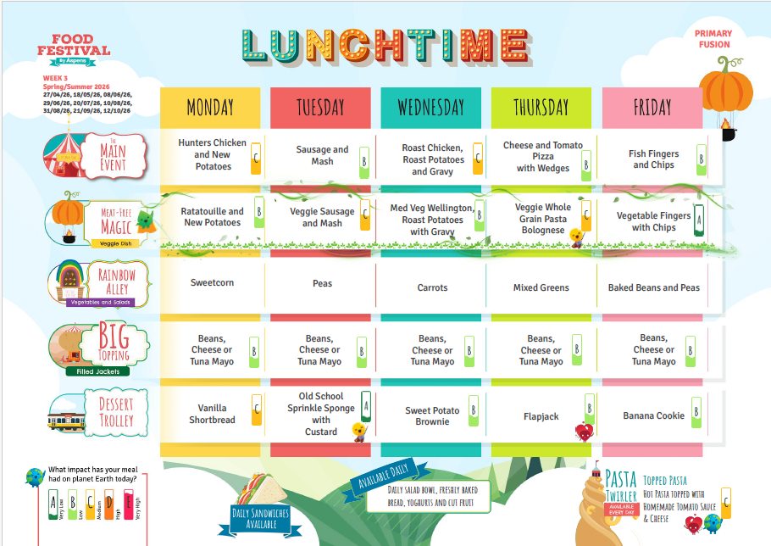

Lunch menu for w.b. 31st Aug 2026
INSET DAY FOR STAFF –
SCHOOL CLOSED
Due to school dinners being cooked fresh, please ensure that you pre order meals that your child will eat. Unfortunately, we cannot offer alternatives.
Ordering school lunches…
We have now moved to our new simplified lunch ordering system, a single login system via ParentPay
https://www.parentpay.com/

Slide 14




Head Teacher’s
Awards
Reception – Enzo – for making a brilliant start to Reception – sharing kindness and love to everyone.
Year 1 – Lola – for displaying a positive attitude towards learning and setting an example for the rest of the class.
Year 2 – Hunter M – for an amazing start to Year 2! Your positive attitude and smile is a pleasure to have in the classroom.
Year 3 – John-Paul – for putting our mission into action and using your creative gifts to make others smile.
Year 4 – Lincoln – for a wonderfully curious and kind attitude to his learning and his friends.
Year 5 – Ngoc Anh – for an incredible attitude to learning and effort across all subjects.
Year 6 – Harry – for a fantastic first week back! You have worked hard, made positive choices and shown great focus ☺ Keep it up!

Slide 15

Food Pantry

Slide 16

Diary Dates
Autumn Term 2026
Monday 20th July – INSET day for staff SCHOOL CLOSED FOR PUPILS UNTIL SEPTEMBER
Term dates 2026 - 2027
 | Term starts | Half term | Term ends
Autumn | Tuesday 1 September 2026 | Monday 26 October 2026 to Friday 30 October 2026 | Friday 18 December 2026
Spring | Monday 4 January 2027 | Monday 15 February 2027 to Friday 19 February 2027 | Thursday 25 March 2027
Summer | Monday 12 April 2027 | Monday 31 May 2027 to Friday 4 June 2027 | Wednesday 21 July 2027
Inset days: 1st September, 2nd November, 4th January, 12th February, 7th June, 21st July

Slide 17

P.E Days
Week beginning Monday 31st August
Please remember that earrings MUST NOT be worn on PE days.

