Slide 1
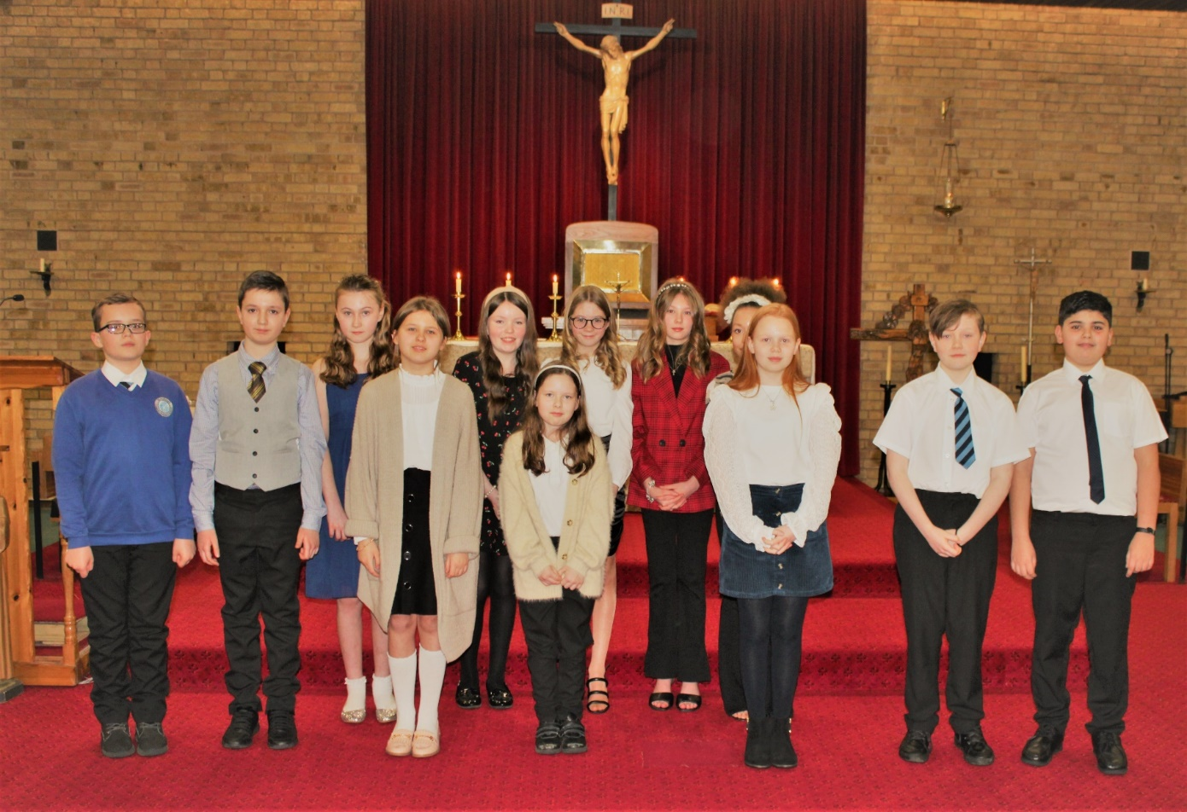


Year 6 Confirmation - Thursday 3rd March 2022
strengthening or deepening our relationship with God

